Slide 1
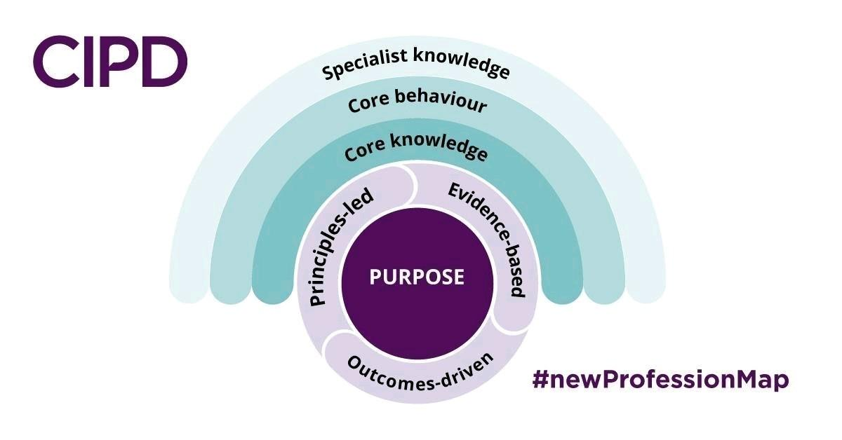

norman@learn4s.com

Slide 2

Who we work with.....

Slide 3
Some Performance Management
Problems
Take up valuable staff time
Seem “old fashioned” clunky
Paper based or Paper based
system on line
Not Tailored to the individual, Team and division
No Feedback to affirm or adjust behaviour
No Measurement in place, including that of our culture
No S.M.A.R.T. goals or ongoing coaching conversations as part of the process -

Slide 4
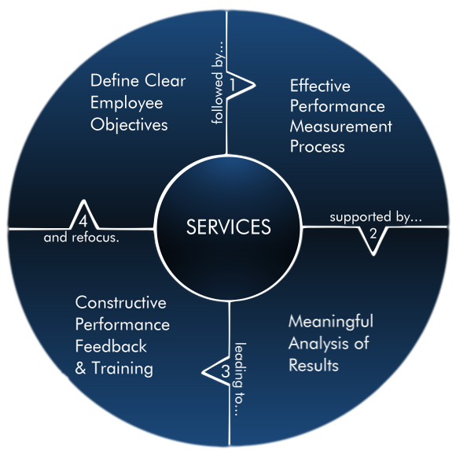

Slide 5

Our Approach.....
"
"Start with the customer and work back to the technology"

Slide 6
Benefits of this System
1. Peer and Upward Appraisals
2. Tailored to the individual
3. Affirm or Adjust behaviours
4. Dynamic Goal Setting
5. Links Measurable Performance
feedback to Training
User name: Reviews4U please do click here
Password : demo18:_gr8
http://www.selectstrategy.com/reviews

Slide 7
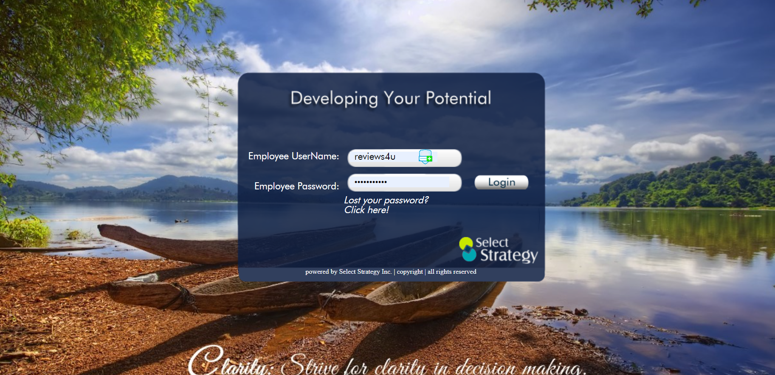

Slide 8
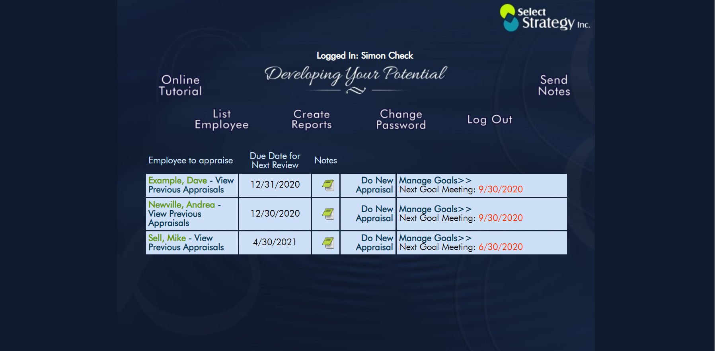

Slide 9
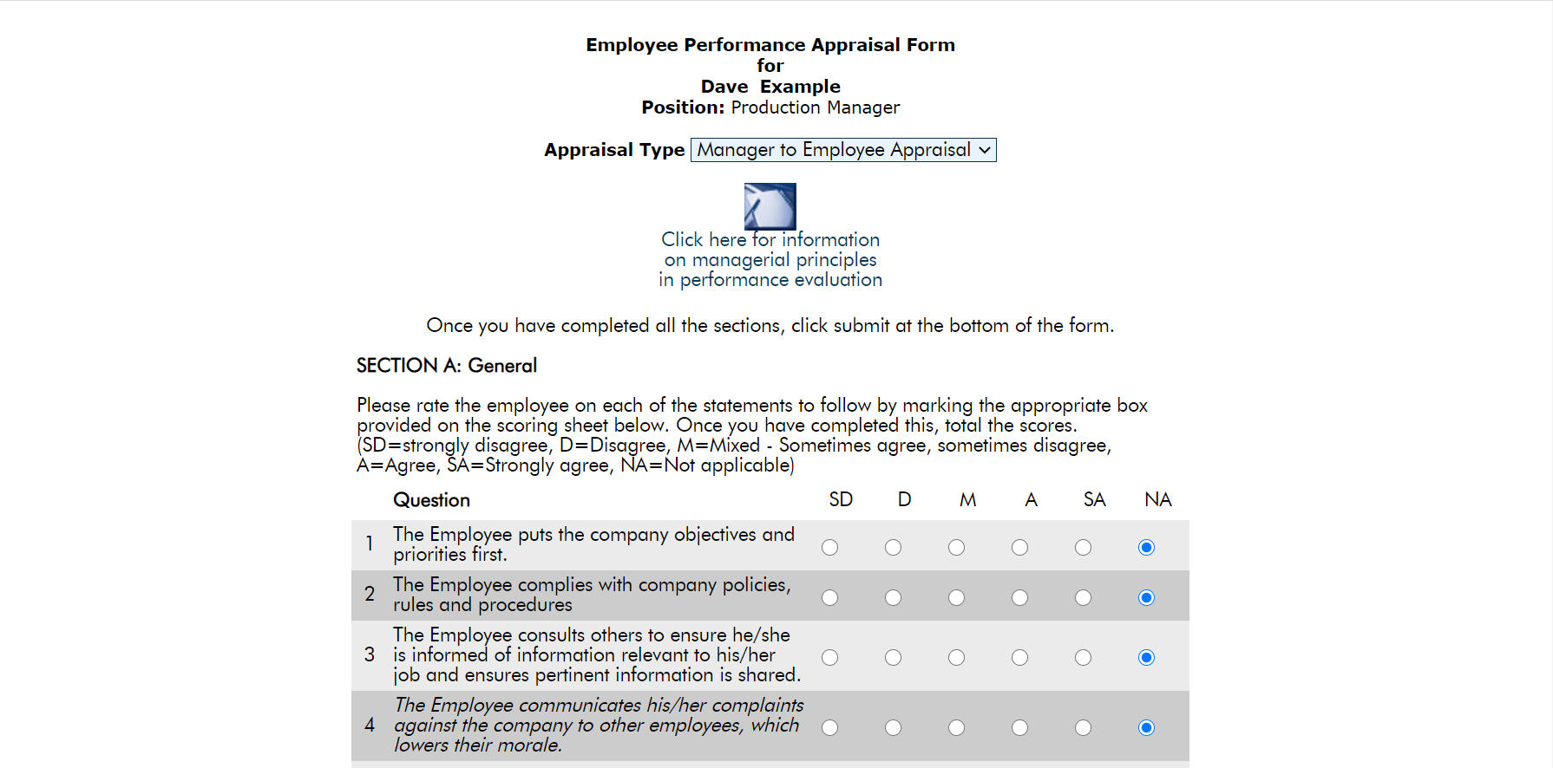

Slide 10
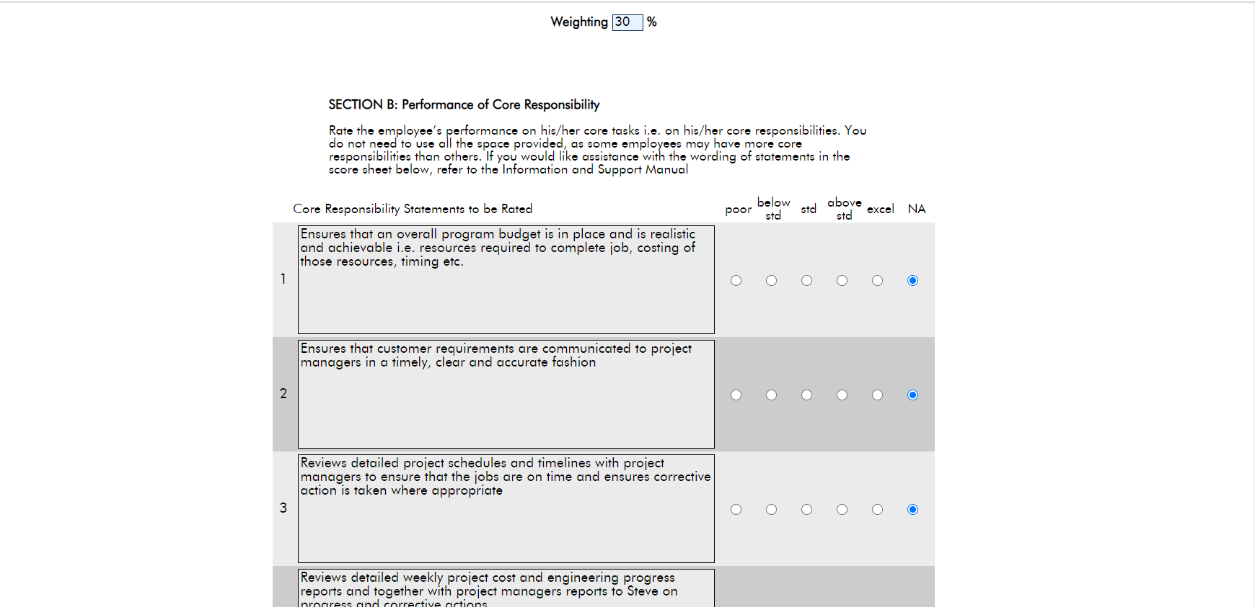

Slide 11
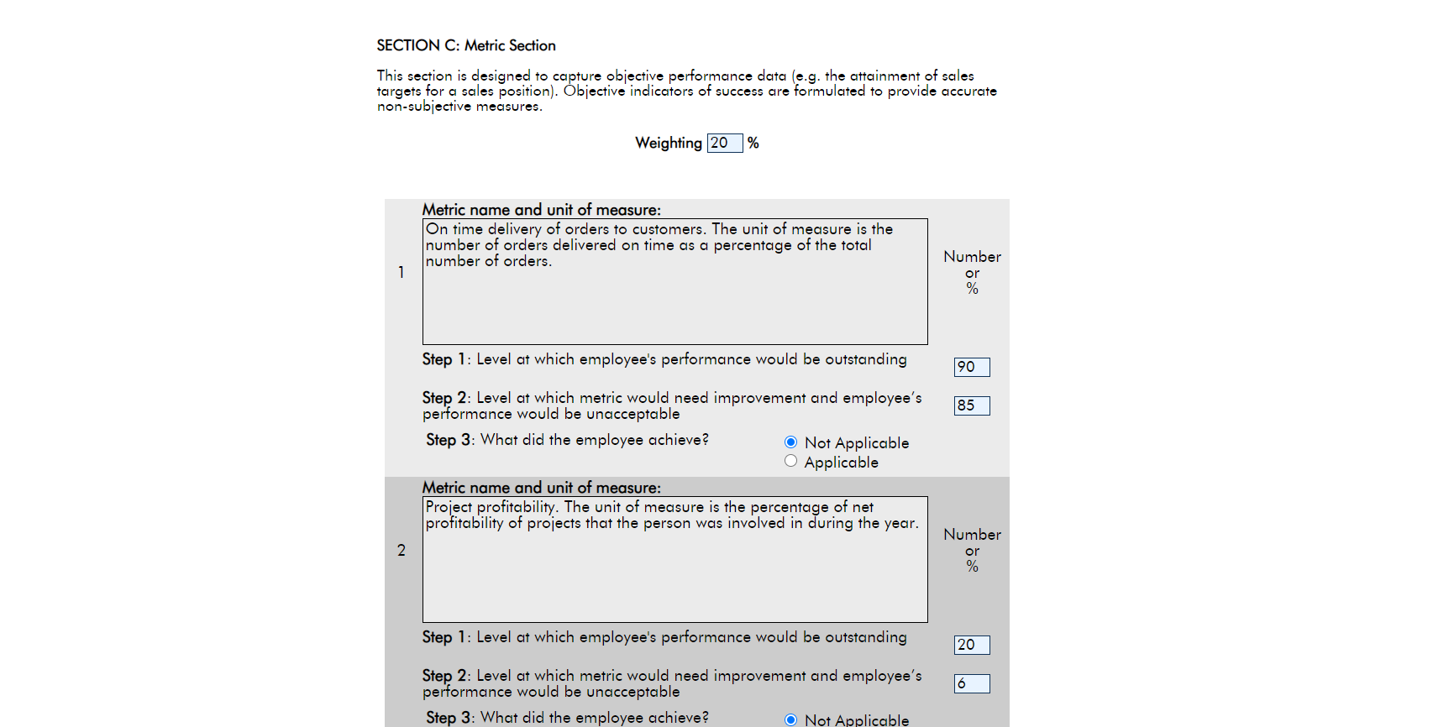

Slide 12
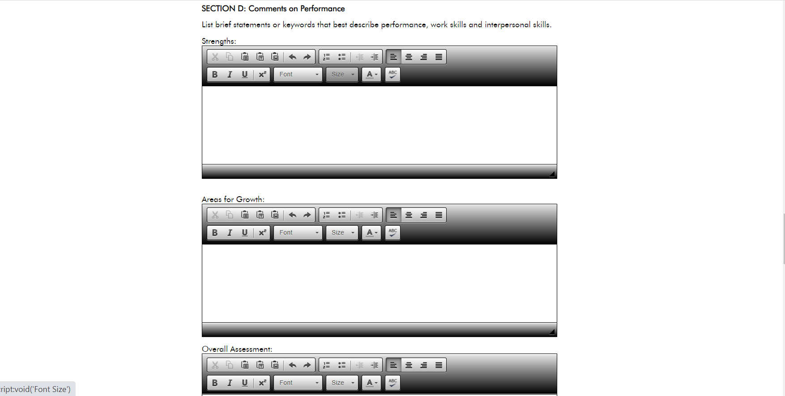

Slide 13
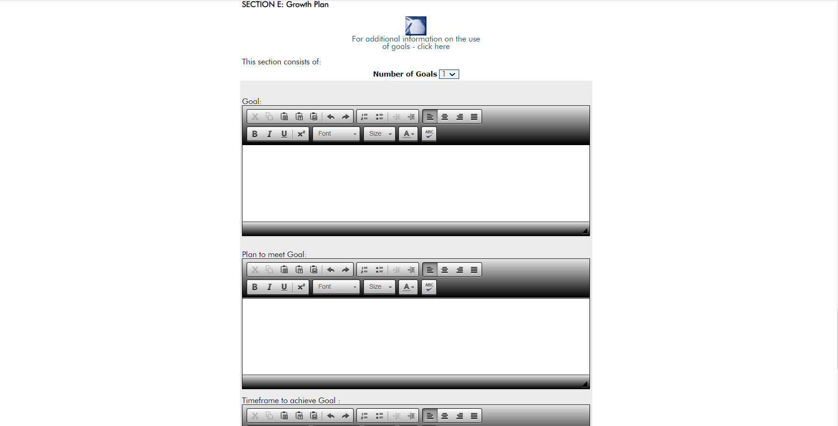

Slide 14
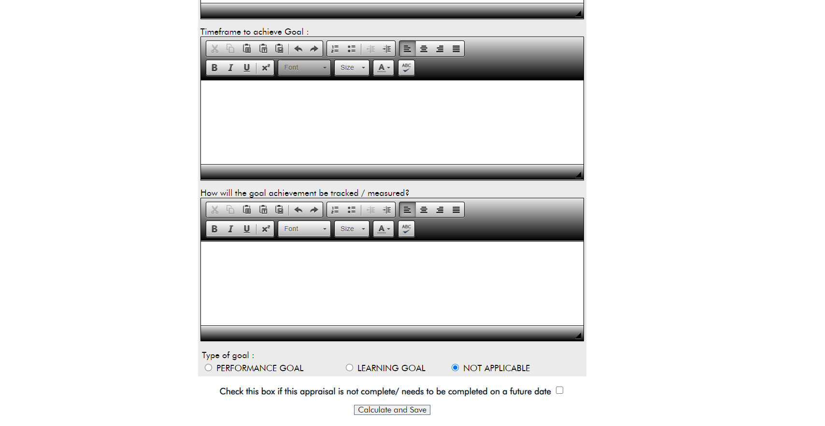

Slide 15


Next Steps……
Do Contact
norman@learn4s.com
For a more in-depth conversation, on our
Cost effective, tailored digital performance management…
Go to www.selectstrategy.com
for more information

Slide 16


Thank you
norman@learn4s.com

Slide 17
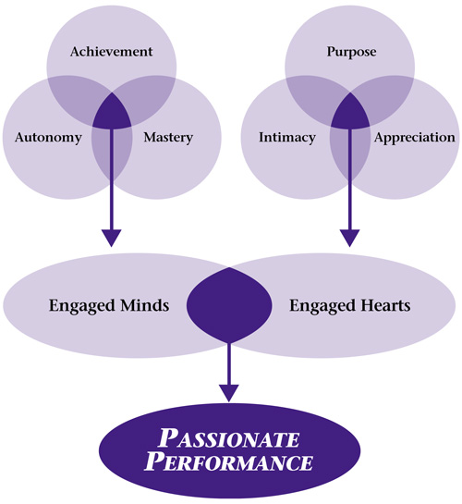
Achieve Task
Build on
Your
Performance
Management
Develop Individuals

Slide 18
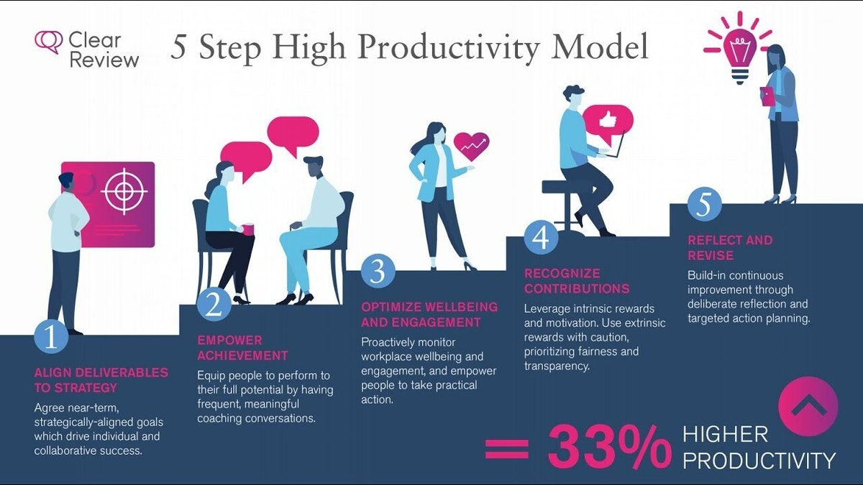

Slide 19
Thank you
norman@learn4s.com

Slide 20
Thank you
norman@learn4s.com

Slide 21
You can login to www.selectstrategy.com/reviews
Use login: admin@democo.com
Password: 4admin_test!

